Slide 1
Between Jackson and the Civil War (1824 – 1860)
Sections 14.1, 14.4, 15.2, 15.4, 15.5

Slide 2
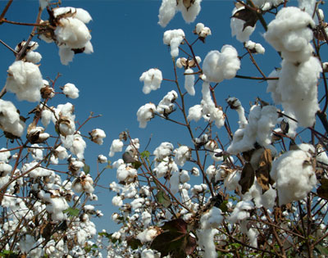
14.1 – The Growth of Cotton
Decline of Upper South in early 1800s
  Slavery dying out
Short-staple cotton hard to grow in Upper South
  How to remove seeds from cotton?
    COTTON GIN invented by ELI WHITNEY
      Removed seeds from fibers
        Birth of the “COTTON KINGDOM” (S.C. to T.X.)
          Big demand overseas $$$
          Huge increase in slavery
            Many shipped from Upper South to Deep South

Slide 3
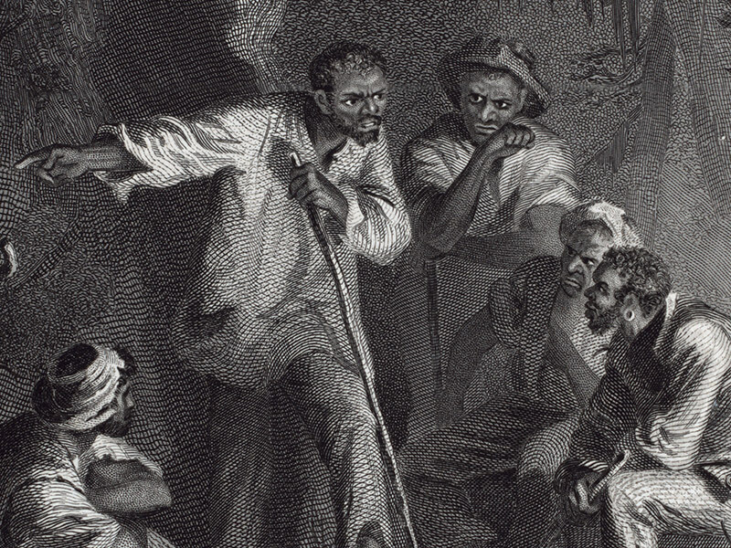
14.4 – The Slave System
Challenging Slavery
  Ways of rebelling
    Working slower
    Running away for a short time
    Escaping to North
    Nat Turner’s Rebellion (1831)
      Nat Turner
        Slave from Virginia
          Believed God had told him to end slavery
            With large group kills many whites and their families
              Captured and killed
                Stricter codes put in place

Slide 4
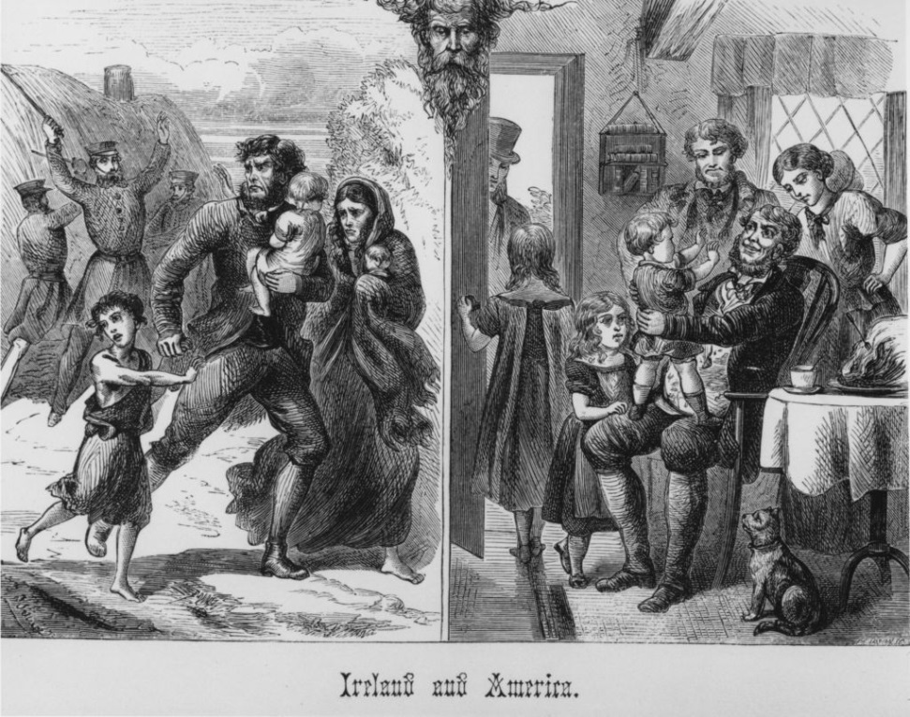
15.2 – Immigrants and Cities
1840-1860
  Large wave of Euro. Immigration
    Irish [Catholic]
      Fled discrimination and poverty
        Oppressed by Protestants
        Potato famine
          Thousands starve
        Most settled in Northeast
          Lived in poor housing
    Germans
      Escaping persecution
        [Failed] Revolution of 1848
      Better economic opportunities in U. S.
      Small number of Jews among population
        Found success in U. S.
      Most settled in Midwest

Slide 5
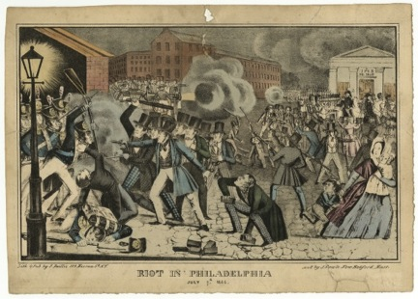
15.2 - Anti-Immigrant Feeling
The Nativist Response
  Immigrants were cheap labor in cities and towns
    Native-born citizens angry
      Felt jobs were being taken (cheap labor)
      Hatred of American Protestants for Catholics (Irish)
        People with these views called NATIVISTS
          Founded political party
            The KNOW-NOTHING PARTY
              Immigrants should live in U. S. 21 years before citizenship granted
              When questioned by outsider on views – “I know nothing.”

Slide 6
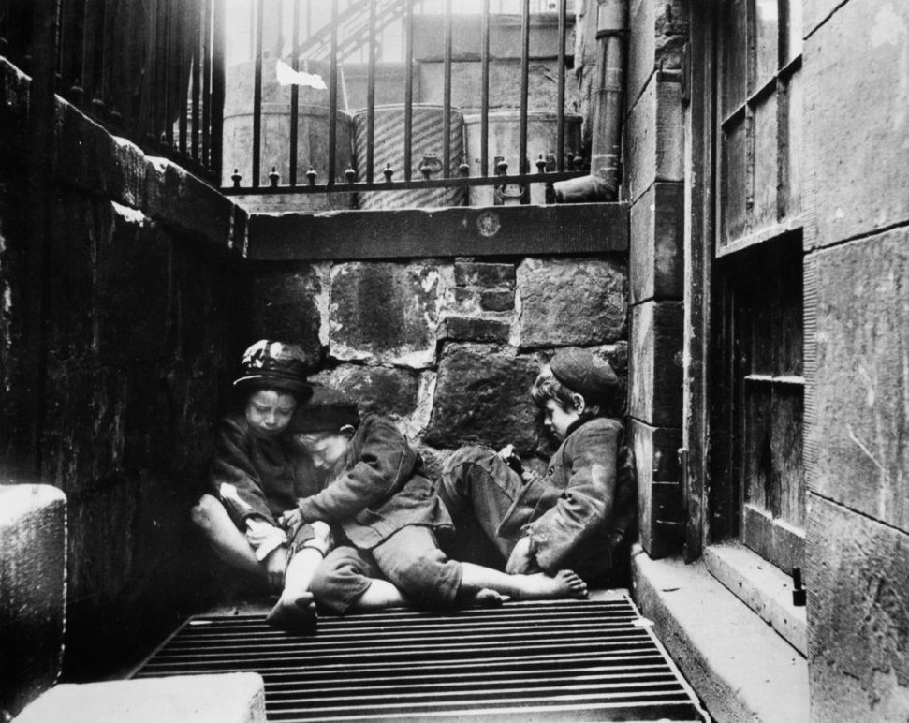
15.2 - Growth of Cities and Urban Problems
Industrial Revolution
  Rise of the MIDDLE CLASS
Urban problems
  Cities overcrowded
  Poor and rich live in close quarters
  TENEMENT housing
  Lack of sanitation
  Criminal activity

Slide 7
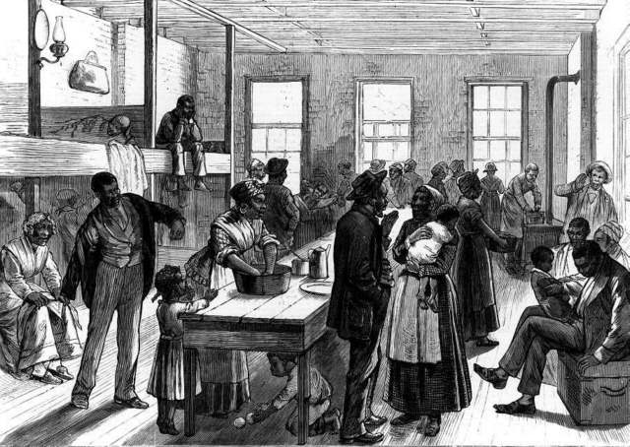
15.4 – The Movement to End Slavery
1830s
  Abolition, or, MOVEMENT to end slavery, begins
    Many want immediate EMANCIPATION, in which all Africans would be free
    Some want to send free blacks back to Africa
      AMERICAN COLONIZATION SOCIETY
        Helped found colony of LIBERIA in Africa

Slide 8
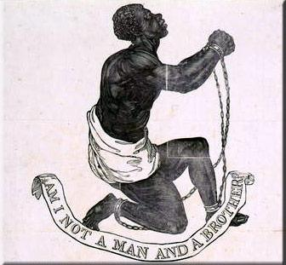
15.4 – Spreading the Abolitionist Message
WILLIAM LLOYD GARRISON
  Published influential abolitionist newspaper, THE LIBERATOR
  Helped found AMERICAN ANTI-SLAVERY SOCIETY
    Wanted immediate emancipation and equality between the “races”

Slide 9
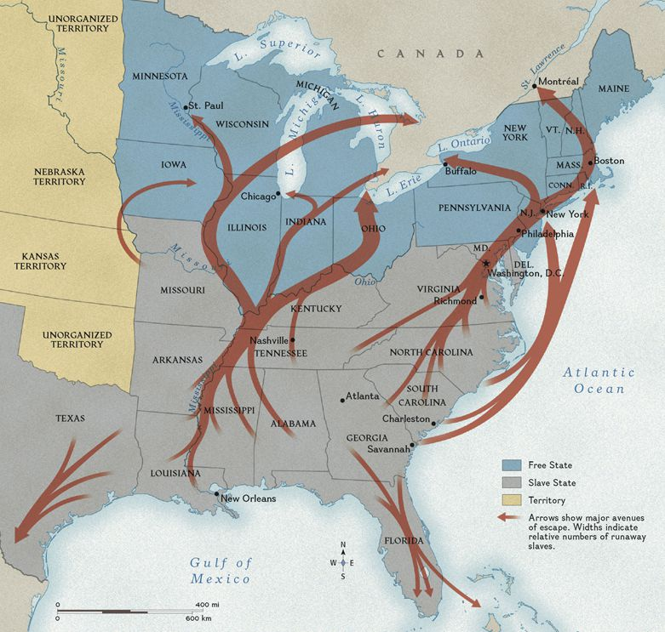
15.4 – African Americans Fight Against Slavery
Frederick Douglas
  Former slave
  Excellent orator
Sojourner Truth
  Dramatic, fiery speeches
The Underground Railroad
  1830s – network created to aid escaped slaves
  Harriet Tubman
    Escaped and returned 19 times to free her family and others

